Slide 1

Statistical Modeling Project – Python
Author – Gaurav Gujar

Slide 2
Project Flow
1. Queried City Bikes API to get bike sharing information
2. Queried Yelp and Foursquare APIs for POIs
3. Completed Data Joining and visualization
4. Model Building – built a regression model

Slide 3
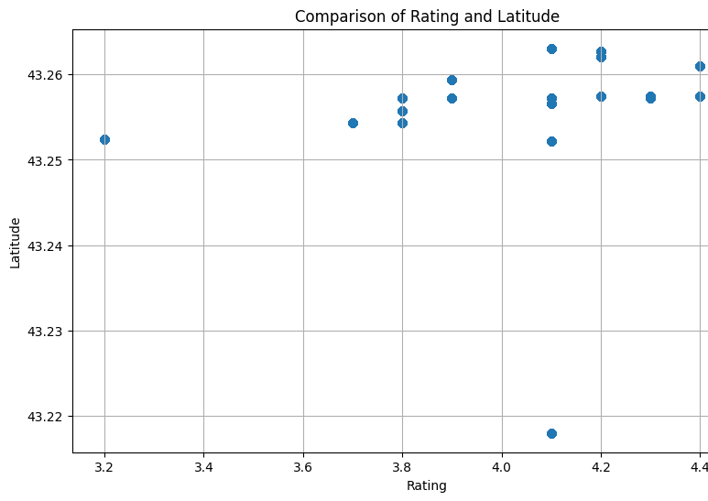

Slide 4
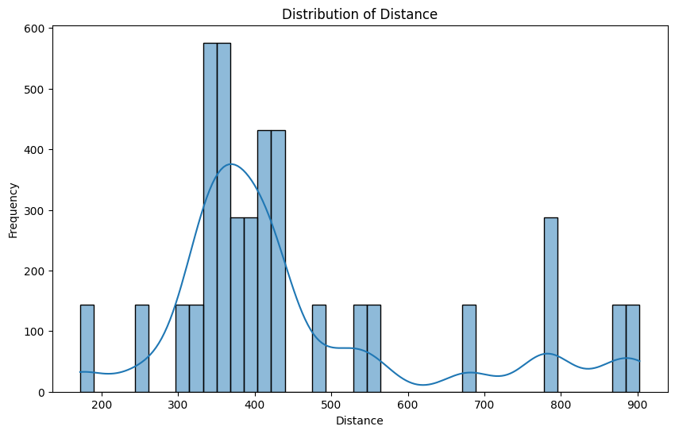

Slide 5
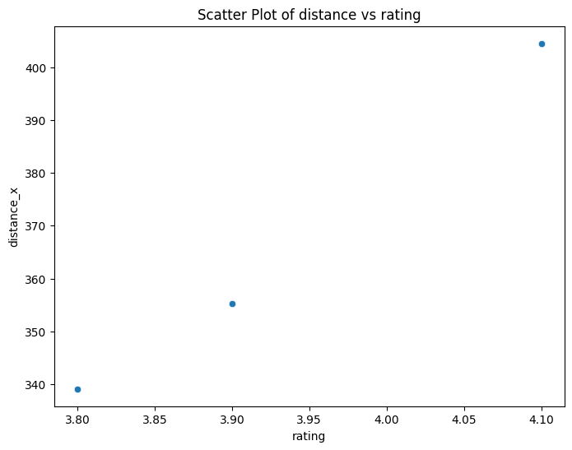
Scatter Plot - Distance vs Rating

Slide 6
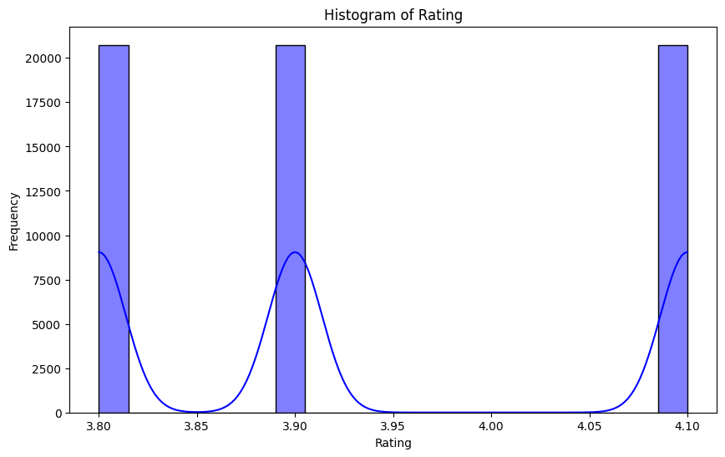
Histogram - Rating

Slide 7
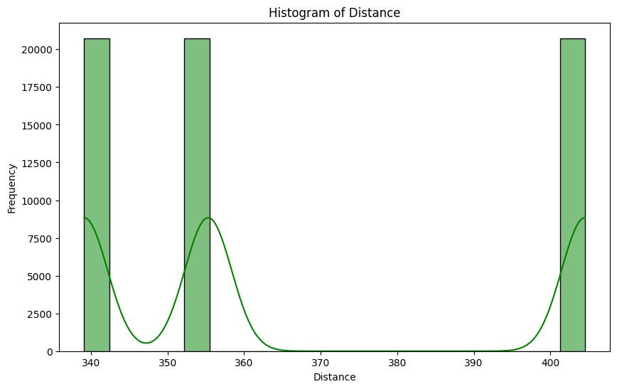
Histogram - Distance

Slide 8
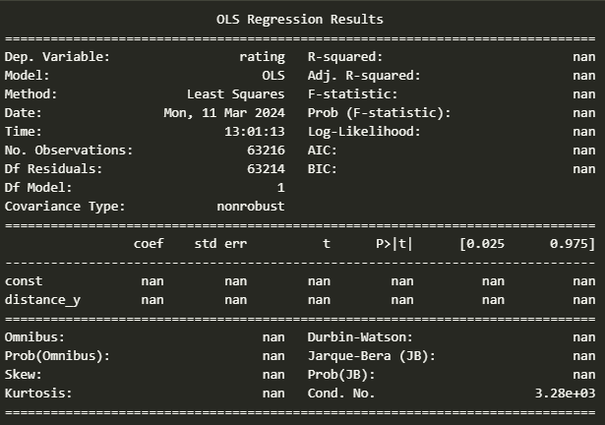
Regression results

